Slide 1
Stakeholders Working Committee Meeting
VIDEOCONFERENCE
MAY 7, 2020

Slide 2
Stakeholders Working Committee Meeting
Agenda
Reflection
COVID-19 Crisis Activity
What could the Border look like after COVID-19?
March Stakeholders Working Committee Meeting Highlights
Initiative Progress

Slide 3
Stakeholders Working Committee Meeting
Reflection
Public health crisis triggers changes in priorities
People involved in the binational day-to-day already live with disruption
Acts of kindness and leadership
Anticipation

Slide 4
Stakeholders Working Committee Meeting
COVID-19 Crisis Activity
Dialogue with stakeholders and COVID-19 Bulletins
Support for companies doing cross border manufacturing
Support for Fundraising efforts
Tijuana Contigo (https://tijuanacontigo.com)
Apoyemos a Tijuana (https://apoyemosatijuana.com)
Fundación SIMNSA (through https://gofundme.com)
Unusual stakeholder needs – Casa de los Pobres

Slide 5
Stakeholders Working Committee Meeting
COVID-19 Crisis Activity
Media interviews and contributions
Border Summit Journalism Awards (part of Border Summit)

Slide 6
Stakeholders Working Committee Meeting
What could the Border look like after COVID-19?
2 Dimensions
Passenger vehicles and pedestrians
Cargo and supply chains
Awareness and Advocacy

Slide 7
Stakeholders Working Committee Meeting
What could the Border look like after COVID-19?
Passenger vehicles (POVs) and pedestrians
Current restrictions in place until May 21st.
It is difficult to know when restrictions will be lifted.
The flattening of the curve in the U.S. as well as in Mexico may not be enough.
The second wave of the virus may come in the fall or winter.
The electoral cycle in the United States is highlighting health and immigration issues.

Slide 8
Stakeholders Working Committee Meeting
What could the Border look like after COVID-19?
POV and pedestrians, cont.
Mexico’s timing.
Monitoring challenges for Mexico.
Risk aversion.

Slide 9
Stakeholders Working Committee Meeting
What could the Border look like after COVID-19?
POV and pedestrians, cont.
What would NOT be surprising:
Customs and Border Protection (CBP) processes will put more emphasis on security – public health will be paramount.
CBP will strengthen its connection with Health and Human Services.

Slide 10
Stakeholders Working Committee Meeting
What could the Border look like after COVID-19?
POV and pedestrians, cont.
What would NOT be surprising:
CBP will accelerate the use of biometrics.
Emphasis will be on crosser data.

Slide 11
Stakeholders Working Committee Meeting
What could the Border look like after COVID-19?
Cargo and Supply Chains
Though cargo has been prioritized, cargo volume is down by at least 50% based on lower demand on both sides of the border.
The crisis uncovered a supply chain sensitivity issue.
There is no clear agreement or binational consensus as to how to preserve our cross border supply chains.

Slide 12
Stakeholders Working Committee Meeting
What could the Border look like after COVID-19?
Cargo and Supply Chains
There will be a rearrangement of global supply chains.
The rearrangement will offer a golden opportunity to the U.S.-Mexico border.
Tijuana must be better prepared to take advantage of this opportunity.

Slide 13
Stakeholders Working Committee Meeting
What could the Border look like after COVID-19?
Cargo and Supply Chains
Evolution towards pre-validation -- strong move to virtual inspections, from the customs standpoint.

Slide 14
Stakeholders Working Committee Meeting
What could the Border look like after COVID-19?
Awareness and Advocacy
Harmonize commercial and health processes and criteria to protect supply chains.
Improve coordination between federal authorities with border states and municipalities.
Ensure that traveler and cargo inspection and health checks do not become obstacles at the ports.
More data = more surveillance and privacy concerns.

Slide 15
Stakeholders Working Committee Meeting
Next meeting will be in Tijuana on July 9 (or videoconference)
2020 Meetings:
September 3, San Diego (San Diego Foundation)
November 5, Tijuana
THANK YOU

Slide 16
Stakeholders Working Committee Meeting
Insights: Latest Crossing Stats
Week of March 2 compared with week of April 27:
Overall (all California/Baja California) Pedestrian crossing reduction: 71%
Overall (all California/Baja California) POV crossing reduction: 49%
San Ysidro: 53% reduction in pedestrians, 53% reduction in POVs.
Otay Mesa: 65% reduction in pedestrians, 42% reduction in POVs.
Tecate: 60% reduction in pedestrians, 58% reduction in POVs.
CBX: 89% reduction in pedestrians.

Slide 17
Stakeholders Working Committee Meeting
March Stakeholders Meeting Highlights
Councilmember Vivian Moreno’s Priorities:
San Ysidro Intermodal Transportation Center; Otay Mesa POE modernization and expansion project; Otay Mesa truck route Phase 4 (widening and paving existing east/west service road along border fence on La Media Road); State Route 11 connection to new port; Enhanced Infrastructure Financing District Public Financing Authority for Otay Mesa; Tijuana River Valley.
Jose Marquez of CALTRANS on 2021 Border Master Plan Update:
Led by Caltrans and SIDUE – port of entry and transportation infrastructure projects. 17 U.S. agencies and 14 Mexican agencies involved in total.
Updates socioeconomic and border crossing data, 2010-2040 and provides recommendations.
Wants to expand outreach to community groups and private sector stakeholders in border region. Is asking Smart Border Coalition to become part of this. Wants to develop process to manage border as one system, considering innovative efforts of stakeholders.

Slide 18
Stakeholders Working Committee Meeting
March Stakeholders Meeting Highlights
Rafael Fernandez de Castro on Border Summit:
Effort from Center for U.S.-Mexican Studies, Union Tribune, Tijuana Innovadora, James Clark and Smart Border Coalition.
April 1 and 2 event will highlight journalism awards, Mexican Ambassador to the U.S., Lieutenant Governor Eleni Kounalakis, and Governors of Baja California and Baja Sur. Panels on “The Three Californias”, the future of cross-border energy and infrastructure and migration. EVENT WAS POSTPONED.
INAMI (Migration Institute) on approach to Corona Virus:
Procedure recently implemented for people who have recently visited Chinese cities at most risk.
Local INAMI directors are working with the federal health ministry.
There is a questionnaire that each port will use for each arrival. INAMI Tijuana can inspect pedestrians but does not have the capacity to check vehicles.

Slide 19
Stakeholders Working Committee Meeting
March Stakeholders Meeting Highlights
City of Tijuana on Medical Lane changes:
Old medical lane was not effective. Passes were resold, with many drug stores and non-medical businesses and uncertified doctors profiting handsomely.
50% discount to doctors was eliminated. Today, price is $198 pesos per crossing.
Business Associations can sell passes to certified doctors or to doctors who are medical cluster members. Hotels and restaurants are seen as part of the medical tourism experience, so they are included as “business tourism”. Wait times have been reduced to 15-25 minutes.

Slide 20
Stakeholders Working Committee Meeting
Initiative List and Progress
Puerta de Mexico demolition
The RFQ is still out for the 8-lane connection. Interested parties will visit the site on May 9 and 10. Economic and technical offers expected at the end of May. The process will take up to 4 months. Late last year investment was estimated at $40 million pesos ($1.7 million), 8 lanes (3.8 yard width), distance of 224 yards. There will also be a “Center for Traffic Control and Information” that will measure wait times using WiFi technology. Traffic information to be exchanged between countries.
Export Corridor at Otay Mesa POE
We are analyzing the possibility of working with the Tijuana Local Development Council to facilitate the project’s implementation starting this year. However, COVID-19 has postponed any discussion on this subject. This is a federally driven decision that entails high level conversations with SAT (customs authority) and INDAABIN (customs buildings owner). SAT national head Ricardo Ahued left week of 4/20. There has been no replacement yet.

Slide 21
Stakeholders Working Committee Meeting
Initiative List and Progress
Tecate Railroad
Baja Rail recently completed its contingency operations plan, focusing on preventive health measures for office and field personnel. Rail commercial activity is now down 75%, but in our “new normal,” rail should have a significant role. MTS and CBP should make the Tecate rail crossing a priority. Baja Rail is working on a funding package for the rehabilitation of the old Desert Line.
It was agreed that ADMICARGA and Baja Rail would TOGETHER go to SAT to present the finished executive plan and get formal FINAL authorization for the project. Baja Rail also renewed conversations with MTS to get approval. This has been postponed due to COVID-19 crisis.
Otay East Port of Entry (Otay II)
In Mexico project is stalled. SCT has still not come out with the official proposal for right of way. Project management leadership bid through Banobras continues. SCT has the general description (proyecto general), but does not yet have the infrastructure analysis (proyecto de infraestructura). Executive study for the access road to the port in Tijuana has been completed. Construction was supposed to start in July, but it is unlikely now.

Slide 22
Stakeholders Working Committee Meeting
Initiative List and Progress
Otay East Port of Entry (Otay II, Cont.)
U.S. Side:
Caltrans completed the traffic innovation analysis. The next stage will be project financing.
Construction on SR 11 and connectors is ahead of schedule.
Bid for investment grade study is almost complete. This is the critical document for any financing option. Also working on bid for business case grant request to help finish USA financing.

Slide 23
Stakeholders Working Committee Meeting
Initiative List and Progress
Wait Times: there are potentially 2 wait time measurement projects in store for 2020. One will be paid for by the California Transportation Commission and the other has been commissioned by the GSA. The Tijuana Local Development Council has a pilot project approved for funding.
Signage: due to new priorities, implementation of tourism signage for at least 1 district near San Ysidro POE has been temporarily suspended.
Access Roads: CANACAR (Tijuana transportation association) led a group that proposed a new plan for trucks to access lanes near the Otay Mesa POE. City of Tijuana has started to implement the plan but there are no formal results yet. With cargo wait time reduction due to much less volume, access has not been an issue.
Joint Inspection / Unified Cargo Processing: it continues regularly, with some CBP officers wearing masks. Traffic is down over 50% northbound. There have been 2 COVID-19 driver deaths and a number of Mexican drivers have been infected.

Slide 24
Stakeholders Working Committee Meeting
Social Media
@smartbordercali
Smartbordercoalition
smartbordercali

Slide 25
Stakeholders Working Committee Meeting
Border Journalism Awards
Human Interest
Manuel Ayala Chávez, “Deportados Connacionales a la Deriva”, Periódico Zeta, https://zetatijuana.com/2019/04/deportados-connacionales-a-la-deriva/
Investigative writing
Armando Nieblas del Campo and Cristian Torres Cruz, “Las aguas negras de Kiko Vega”, http://radarbc.com/AguasNegrasKikoVega/
Photography (portfolio)
Omar Martínez, Cuartoscuro

Slide 26
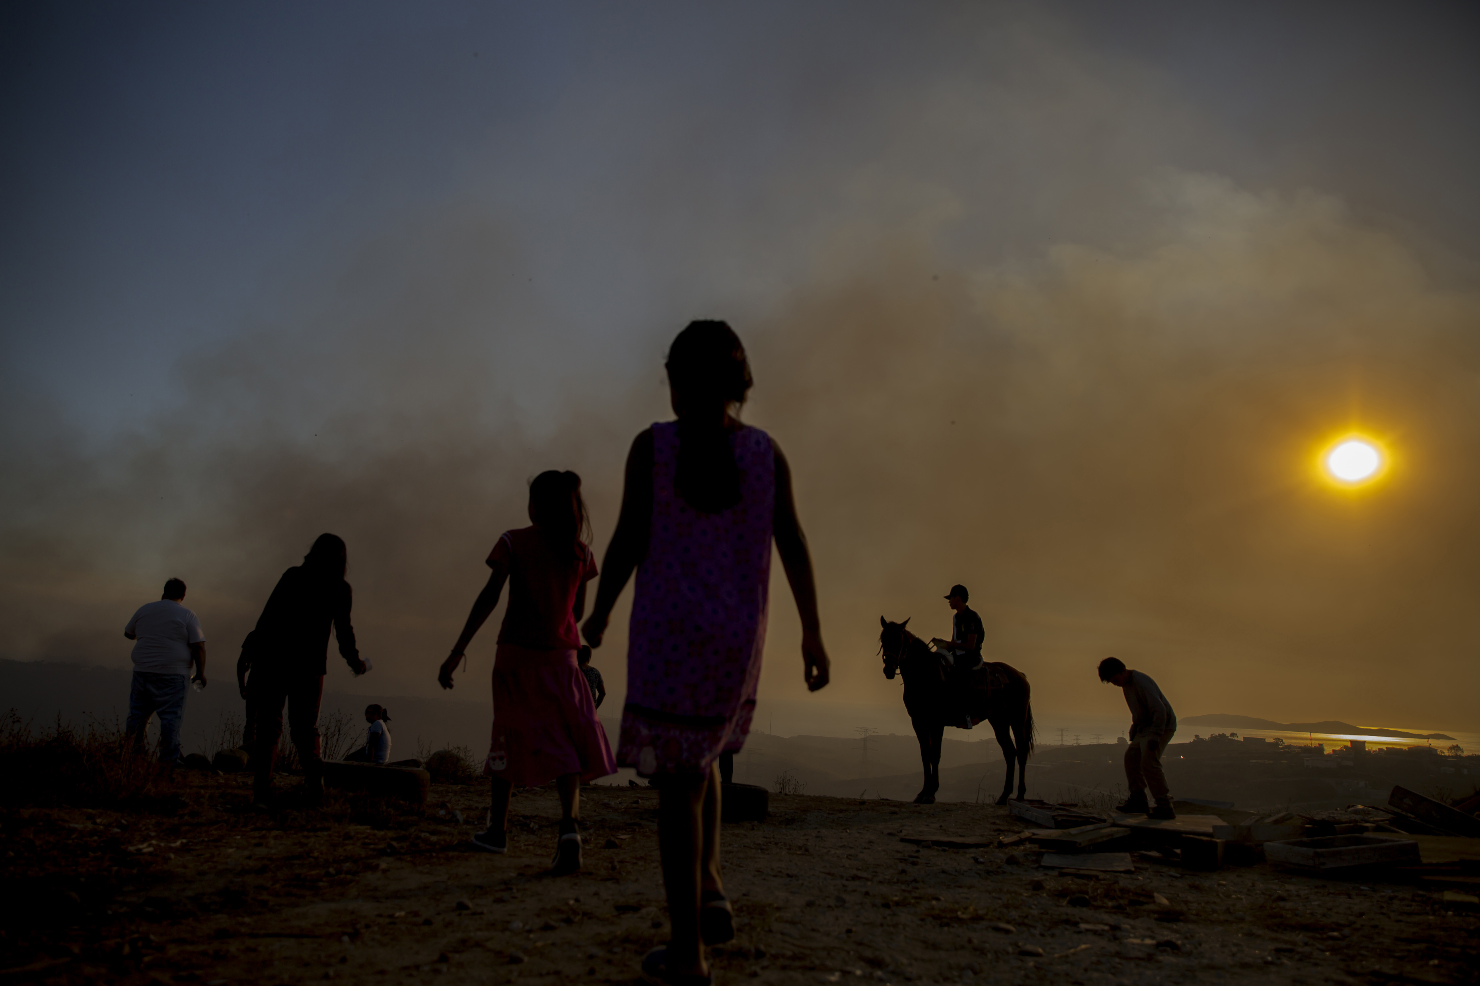
Stakeholders Working Committee Meeting

Slide 27
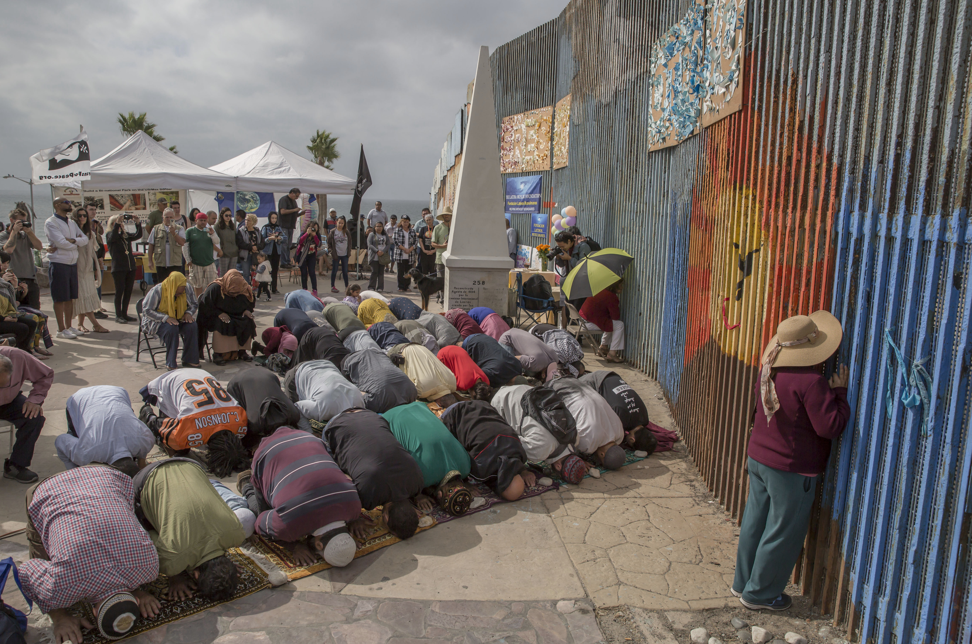
Stakeholders Working Committee Meeting

